Slide 1
Community Benefit and Community Health Needs Assessments
National Association of Counties (NACo)
February 22, 2015
Julie Trocchio
Senior Director, Community Benefit and Continuing Care
Catholic Health Association

Slide 2
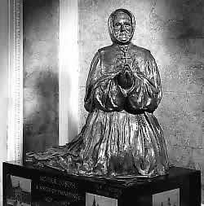
Mother Joseph, born in Montreal, led a group of five missionaries to the Pacific Northwest. She was responsible for the completion of 11 hospitals, 7 academies, 5 Indian schools and 2 orphanages. As architect and artist, she designed and supervised their construction as well as fund raising.

Slide 3
Community Benefit Objectives
Programs or activities that provide treatment or promote health as a
response to community needs
and meets at least one community benefit objective:
  Improve access to health services
  Enhance public health
  Advance knowledge
  Relieve government burden

Slide 4
Community Health Needs
Identified by:
  CHNA
  Request by NFP or government or other documentation
  Partnership with NFP or government

Slide 5
What Is Community Benefit??
Financial Assistance
Government-sponsored indigent health care – unpaid costs of public programs
  -- Medicaid
  -- State Children’s Health Insurance
  Program
  -- Medically indigent programs
Community Benefit Services

Slide 6
What is Community Benefit?
Categories of Community Benefit Services
Community health services
-- Community health education
-- Community-based clinical services
-- Health care support services
-- Social and environmental improvement activities
Health profession education
-- Physicians, medical students
-- Nurses, nursing students
-- Other health professions

Slide 7
What is Community Benefit?
Categories of Community Benefit Services
Subsidized health services
-- Emergency and trauma services
-- Behavioral health
Research
-- Clinical research
-- Community health research
-- Health care delivery innovation

Slide 8
What is Community Benefit?
Categories of Community Benefit Services
Cash and in-kind contributions
-- Cash donations
-- Grants
-- In-kind donations
Community building activities
-- Physical improvements/housing
-- Economic development
-- Environmental improvements
-- Coalition building
-- Advocacy for community health improvement

Slide 9
What is Community Benefit?
A Process:
Community Benefit is a planned, managed, organized and measured approach to health care organizations’ participation in meeting identified community health and health-related needs.

Slide 10

The Process
Building a Sustainable Infrastructure
Assessing Need
Planning
Evaluating
Communicating
Determining What Counts
Accounting for Costs

Slide 11
Questions Raised By Congress
Should the playing field be leveled for not-for-profit and for-profit healthcare?
Are hospitals sufficiently charitable?
Is the community benefit standard for tax-exemption adequate?
Should the revenue ruling for hospital tax-exemption be changed?

Slide 12
Affordable Care Act
Community health need assessment
Implementation strategy
Financial assistance
Charges
Billing/collections
Reporting

Slide 13
Meeting New Requirements for Tax-Exempt Hospitals
Overview of IRC 501(r)
New Penalties
  $50,000 excise tax
  Potential loss of Section 501(c)(3) status with respect to any noncompliant facility

Slide 14
IRS: How is a Community Health Needs Assessment Conducted?
Identify and prioritize significant health needs of the community served by the hospital
May be conducted in collaboration or jointly with others
Must solicit and take into account input from persons who represent the broad interests of the community served including those with special knowledge of or expertise in public health
Written report must adopted by authorized body
Must be made publicly available

Slide 15
IRS: How is Community Health Needs Assessment Documented?
Description of the community served by the hospital
Description of the process used to conduct the assessment
  Sources and dates of the data and other information used;
  Methods of collecting and analyzing data
Description of how information was solicited and used
If the hospital collaborated with others – who?
If the hospital contracted with a consultant – include qualifications

Slide 16
IRS: How is Community Health Needs Assessment Documented? (con’t)
Describe input from persons who represent the broad interests of the community:
Summary of the input of these persons; how and over what time period
Names of organizations providing input and nature and extent of input
Describe the medically underserved, low-income, or minority population being represented by organizations or individuals providing input

Slide 17
IRS: How is Community Health Needs Assessment Documented? (con’t)
A prioritized description of all the significant community health needs identified through the CHNA, including a description of the process and criteria used in prioritizing such health needs
A description of the potential resources identified through the CHNA to address the significant health needs
Evaluation of impact of actions taken since previous CHNA

Slide 18
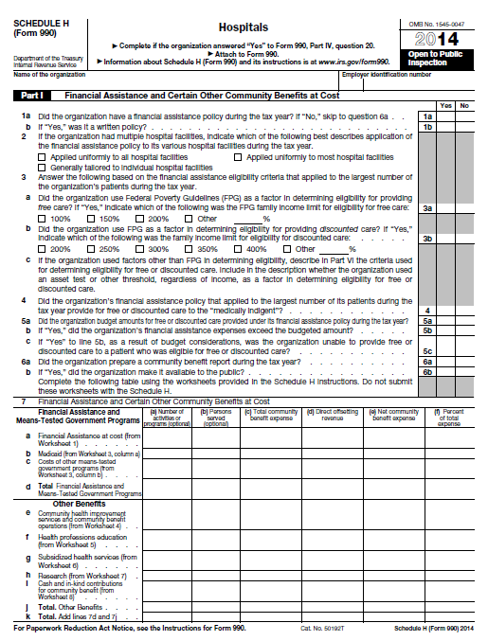
IRS Form 990 Schedule H

Slide 19
IRS: What Does an Implementation Strategy
Include?
The actions the hospital facility intends to take to address the significant health need
The anticipated impact of these actions
The resources the hospital plans to commit to address the health need
Any planned collaboration between the hospital facility and other facilities or organizations

Slide 20
IRS: How is an Implementation Strategy
Documented?
Must be attached to hospital’s IRS Form 990 or provide on the Form 990 the URL(s) to access online
Not required but recommended: post on website
Questions on IRS Form 990 Schedule H

